Slide 1
Neural Networks IV
Tomas Karpati MD tc.datascience@gmail.com
054-2002430

Slide 2
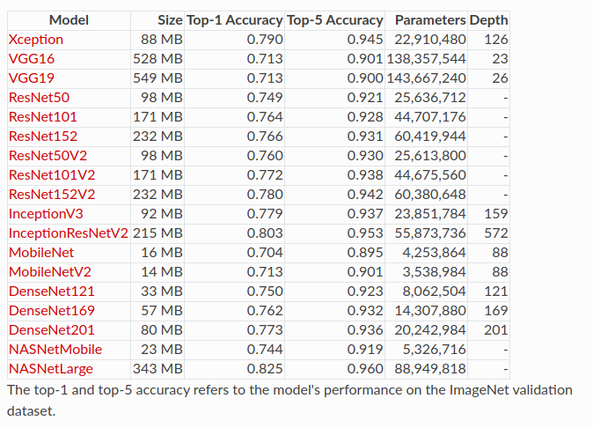
Transfer Learning
from keras.applications.resnet50 import ResNet50
from keras.preprocessing import image
from keras.applications.resnet50 import preprocess_input, decode_predictions
import numpy as np
model = ResNet50(weights='imagenet')
img_path = 'elephant.jpg'
img = image.load_img(img_path, target_size=(224, 224))
x = image.img_to_array(img)
x = np.expand_dims(x, axis=0)
x = preprocess_input(x)
preds = model.predict(x)
# decode the results into a list of tuples (class, description, probability)
# (one such list for each sample in the batch)
print('Predicted:', decode_predictions(preds, top=3)[0])
# Predicted: [(u'n02504013', u'Indian_elephant', 0.82658225), (u'n01871265', u'tusker', 0.1122357), (u'n02504458', u'African_elephant', 0.061040461)]

Slide 3
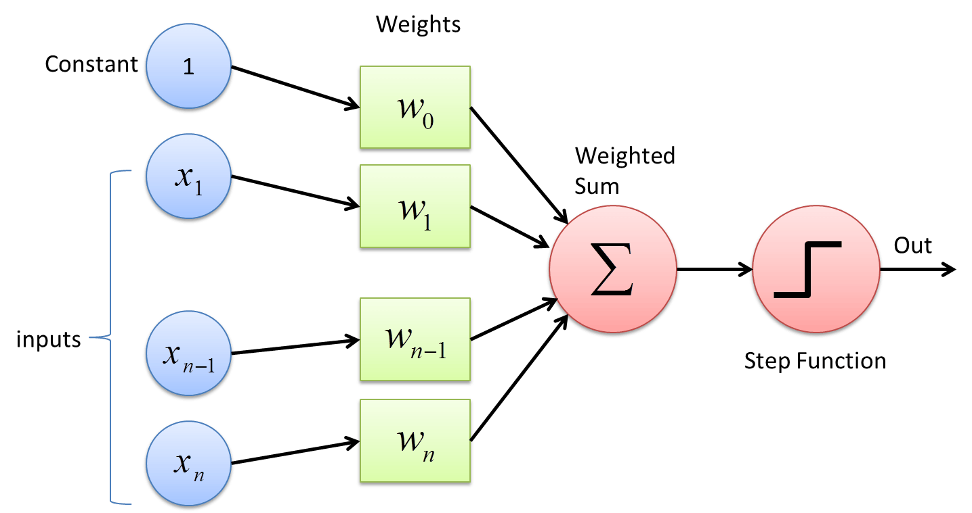
Neural Networks
Perceptrons
Convolutional Neural Networks (ConvNet,CNN)
Recurrent Neural Networks (RNN)
Long / Short Term Memory (LSTM)
Gated Recurrent Unit (GRU)
Hopfield Network
Unsupervised NN’s
Restricted Boltzmann Machine (RBM)
Deep Belief Networks (DBN)
Denoising Autoencoders
Generative Adversarial Network (GAN)

Slide 4
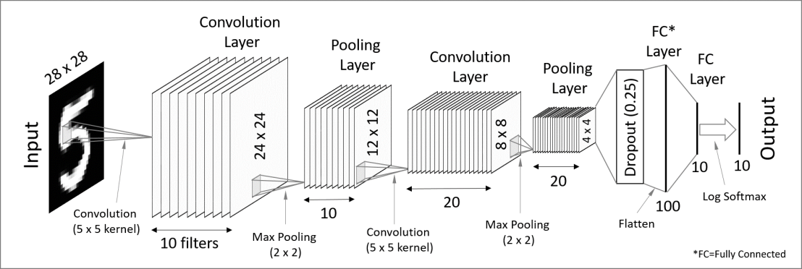
Neural Networks
Perceptrons
Convolutional Neural Networks (ConvNet, CNN)
Recurrent Neural Networks (RNN)
Long / Short Term Memory (LSTM)
Gated Recurrent Unit (GRU)
Hopfield Network
Unsupervised NN’s
Restricted Boltzmann Machine (RBM)
Deep Belief Networks (DBN)
Denoising Autoencoders
Generative Adversarial Network (GAN)

Slide 5


Neural Networks
Perceptrons
Convolutional Neural Networks (ConvNet, CNN)
Recurrent Neural Networks (RNN)
Long / Short Term Memory (LSTM)
Gated Recurrent Unit (GRU)
Hopfield Network
Unsupervised NN’s
Restricted Boltzmann Machine (RBM)
Deep Belief Networks (DBN)
Denoising Autoencoders
Generative Adversarial Network (GAN)

Slide 6
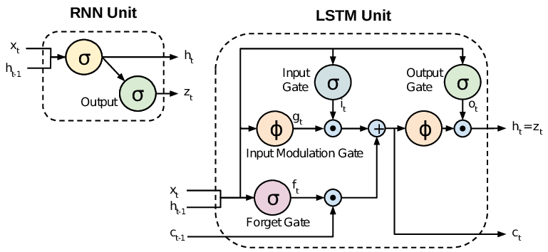
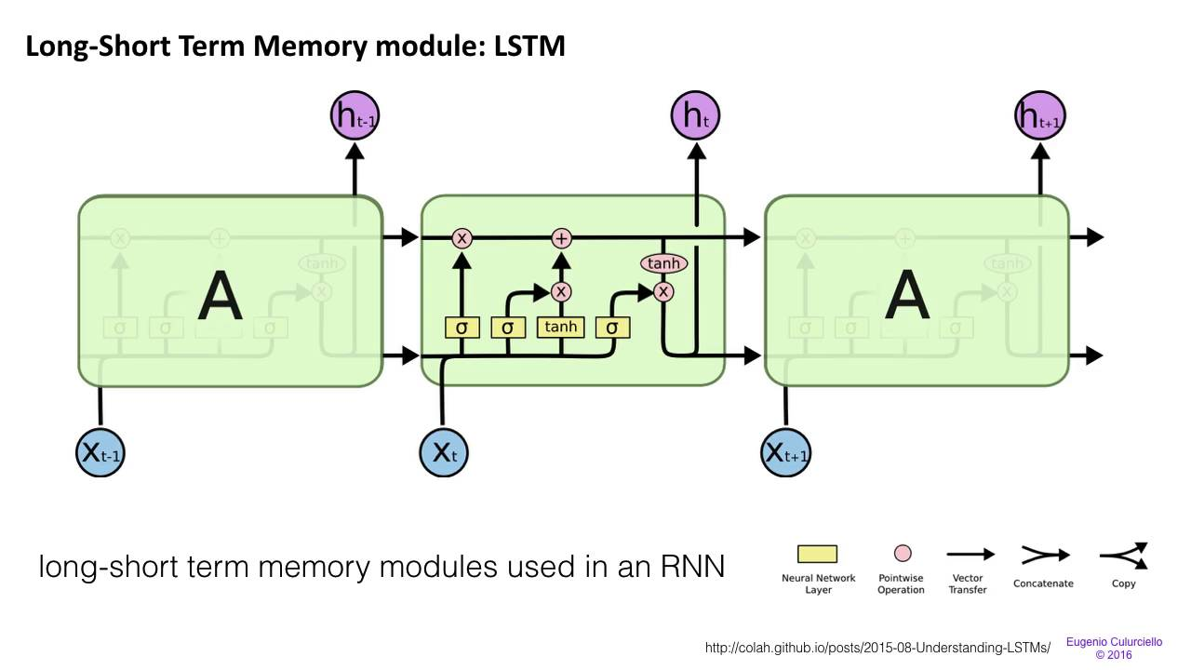
Neural Networks
Perceptrons
Convolutional Neural Networks (ConvNet, CNN)
Recurrent Neural Networks (RNN)
Long / Short Term Memory (LSTM)
Gated Recurrent Unit (GRU)
Hopfield Network
Unsupervised NN’s
Restricted Boltzmann Machine (RBM)
Deep Belief Networks (DBN)
Denoising Autoencoders
Generative Adversarial Network (GAN)

Slide 7
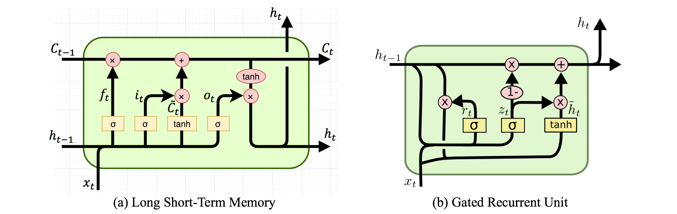
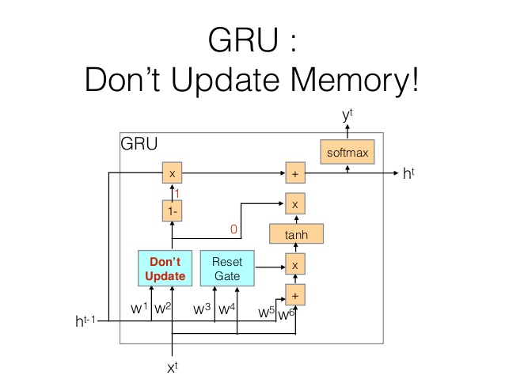
Neural Networks
Perceptrons
Convolutional Neural Networks (ConvNet, CNN)
Recurrent Neural Networks (RNN)
Long / Short Term Memory (LSTM)
Gated Recurrent Unit (GRU)
Hopfield Network
Unsupervised NN’s
Restricted Boltzmann Machine (RBM)
Deep Belief Networks (DBN)
Denoising Autoencoders
Generative Adversarial Network (GAN)

Slide 8
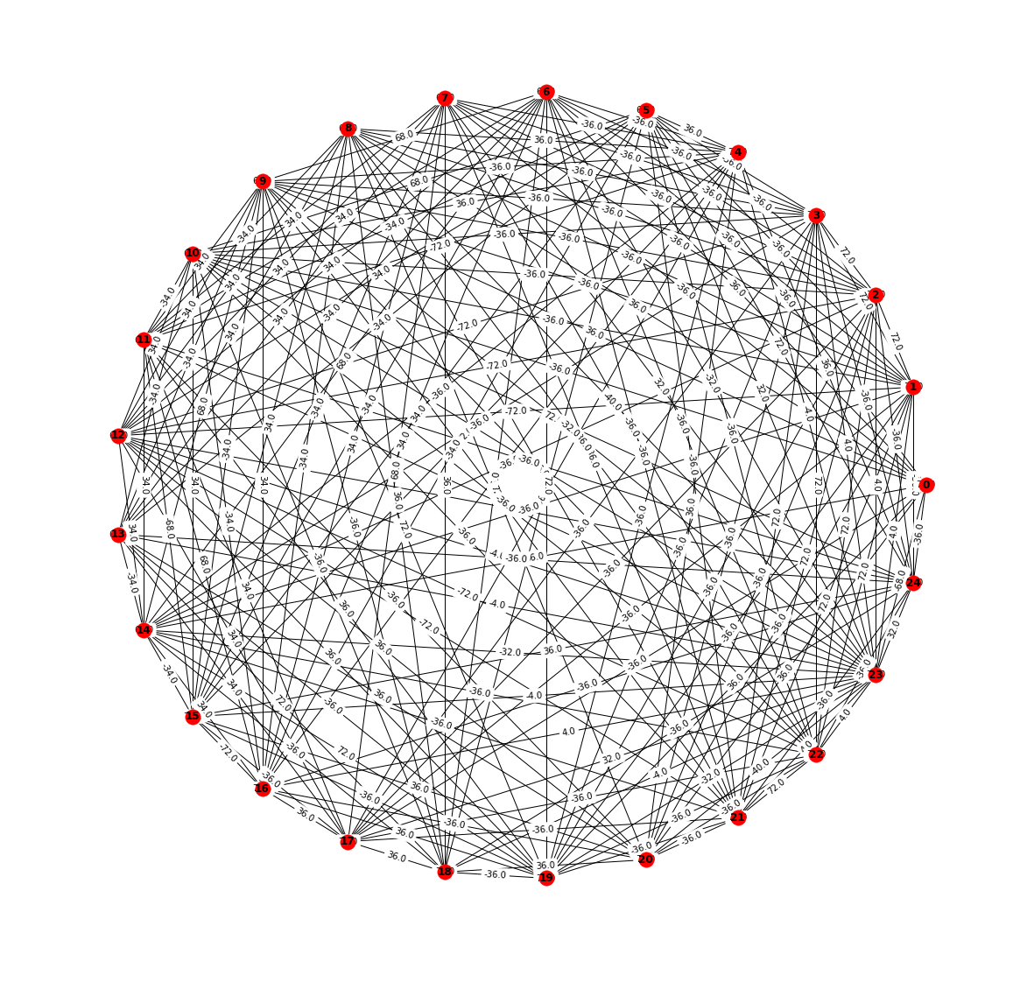
Neural Networks
Perceptrons
Convolutional Neural Networks (ConvNet, CNN)
Recurrent Neural Networks (RNN)
Long / Short Term Memory (LSTM)
Gated Recurrent Unit (GRU)
Hopfield Network
Unsupervised NN’s
Restricted Boltzmann Machine (RBM)
Deep Belief Networks (DBN)
Denoising Autoencoders
Generative Adversarial Network (GAN)

Slide 9
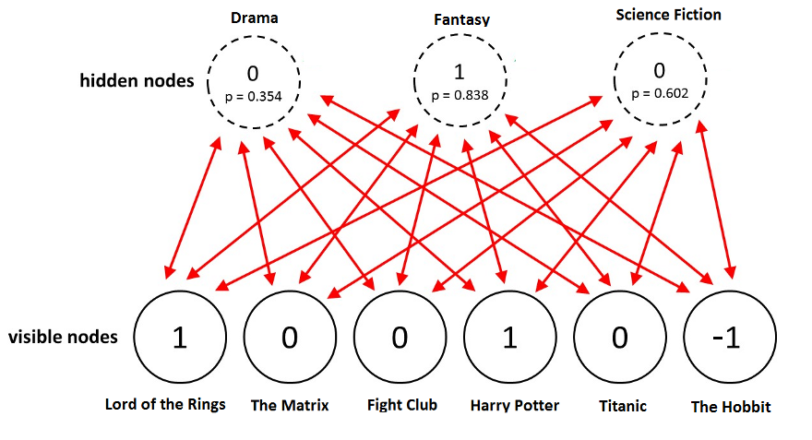
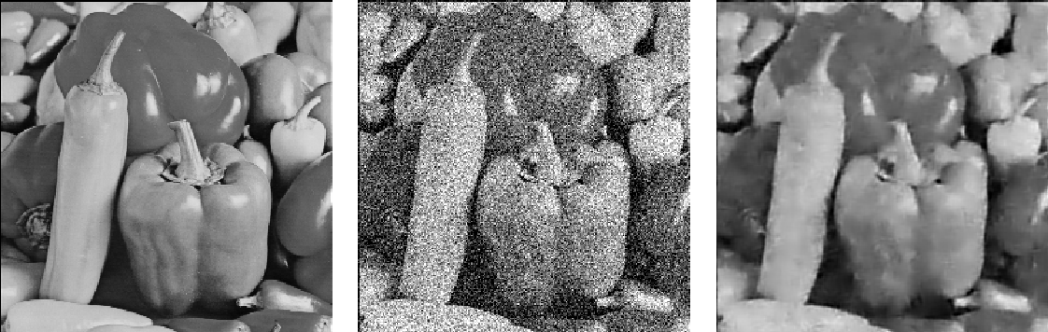
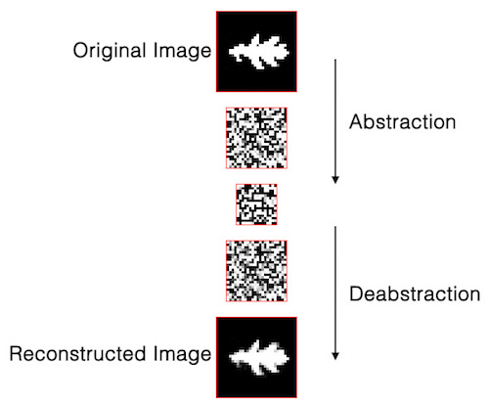
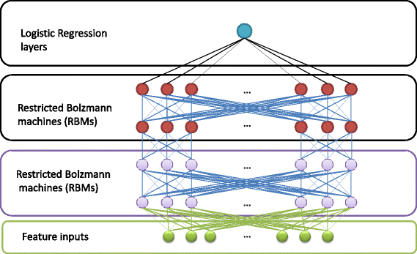
Neural Networks
Perceptrons
Convolutional Neural Networks (ConvNet, CNN)
Recurrent Neural Networks (RNN)
Long / Short Term Memory (LSTM)
Gated Recurrent Unit (GRU)
Hopfield Network
Unsupervised NN’s
Restricted Boltzmann Machine (RBM)
Deep Belief Networks (DBN)
Autoencoders
Generative Adversarial Network (GAN)

Slide 10
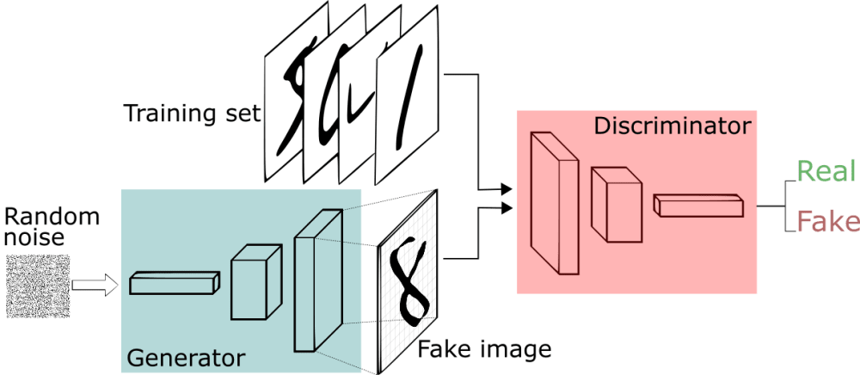
Neural Networks
Perceptrons
Convolutional Neural Networks (ConvNet, CNN)
Recurrent Neural Networks (RNN)
Long / Short Term Memory (LSTM)
Gated Recurrent Unit (GRU)
Hopfield Network
Unsupervised NN’s
Restricted Boltzmann Machine (RBM)
Deep Belief Networks (DBN)
Denoising Autoencoders
Generative Adversarial Network (GAN)

Slide 11
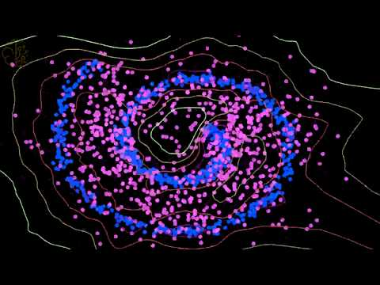
Neural Networks
Perceptrons
Convolutional Neural Networks (ConvNet, CNN)
Recurrent Neural Networks (RNN)
Long / Short Term Memory (LSTM)
Gated Recurrent Unit (GRU)
Hopfield Network
Unsupervised NN’s
Restricted Boltzmann Machine (RBM)
Deep Belief Networks (DBN)
Denoising Autoencoders
Generative Adversarial Network (GAN)

Slide 12
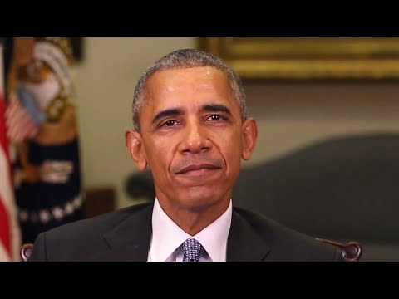
Neural Networks
Perceptrons
Convolutional Neural Networks (ConvNet, CNN)
Recurrent Neural Networks (RNN)
Long / Short Term Memory (LSTM)
Gated Recurrent Unit (GRU)
Hopfield Network
Unsupervised NN’s
Restricted Boltzmann Machine (RBM)
Deep Belief Networks (DBN)
Denoising Autoencoders
Generative Adversarial Network (GAN)

Slide 13
Neural Networks
Be careful with Neural Networks !
One Pixel Attack - https://arxiv.org/pdf/1710.08864.pdf
Fake Reality
Fake Individuals - https://thispersondoesnotexist.com/
Fake Speeches
Fake Faces
Fake Movies
Fake Pictures
Fake News
Fake Scientific Papers

Slide 14
Neural Networks
NN Architectures (https://towardsdatascience.com/the-mostly-complete-chart-of-neural-networks-explained-3fb6f2367464)
Perceptrons
Convolutional Neural Networks (ConvNet)
Recurrent Neural Networks (RNN)
Long / Short Term Memory (LSTM)
Gated Recurrent Unit (GRU)
Hopfield Network
Unsupervised NN’s
Restricted Boltzmann Machine (RBM)
Deep Belief Networks (DBN)
Denoising Autoencoders
Generative Adversarial Network (GAN)

